Slide 1
IUC AI Symposium June 11, 2024
In 2023, several studies assessed AI’s impact on labor, suggesting that AI enables workers to complete tasks more quickly and to improve the quality of their output.
Nestor Maslej, Loredana Fattorini, Raymond Perrault, Vanessa Parli, Anka Reuel, Erik Brynjolfsson, John Etchemendy, Katrina Ligett, Terah Lyons, James Manyika, Juan Carlos Niebles, Yoav Shoham, Russell Wald, and Jack Clark, “The AI Index 2024 Annual Report,” AI Index Steering Committee, Institute for Human-Centered AI, Stanford University, Stanford, CA, April 2024. https://aiindex.stanford.edu/wp-content/uploads/2024/04/HAI_AI-Index-Report-2024.pdf

Slide 2
IUC AI Symposium June 11, 2024
Most organizations (75%) expect AI technology to affect their talent strategies within two years. 32% of organizations that reported “very high” levels of Generative AI expertise are already making changes.
https://www2.deloitte.com/content/dam/Deloitte/us/Documents/consulting/us-state-of-gen-ai-report-q2.pdf

Slide 3
IUC AI Symposium June 11, 2024
GPT-4 has an estimated
1.76 trillion parameters

Slide 4
IUC AI Symposium June 11, 2024
In the short term, more organizations said they expect AI technology to increase head count (39%) than to decrease head count (22%)—perhaps due to increased needs for Generative AI and data expertise.
https://www2.deloitte.com/content/dam/Deloitte/us/Documents/consulting/us-state-of-gen-ai-report-q2.pdf

Slide 5
IUC AI Symposium June 11, 2024
The most expected talent strategy impacts from AI are process redesign (48%) and upskilling or reskilling (47%).
https://www2.deloitte.com/content/dam/Deloitte/us/Documents/consulting/us-state-of-gen-ai-report-q2.pdf

Slide 6
IUC AI Symposium June 11, 2024
The share of employed Americans who have used ChatGPT on the job increased from 8% in March 2023 to 20% in February 2024.
https://www.pewresearch.org/short-reads/2024/03/26/americans-use-of-chatgpt-is-ticking-up-but-few-trust-its-election-information/

Slide 7
IUC AI Symposium June 11, 2024
IBM's Watson defeated Ken Jennings and Brad Rutter in Jeopardy in 2011 with a total score of $77,147 over two games.

Slide 8
IUC AI Symposium June 11, 2024
About four-in-ten Americans (38%) don’t trust the information that comes from ChatGPT about the 2024 U.S. presidential election.
https://www.pewresearch.org/short-reads/2024/03/26/americans-use-of-chatgpt-is-ticking-up-but-few-trust-its-election-information/

Slide 9
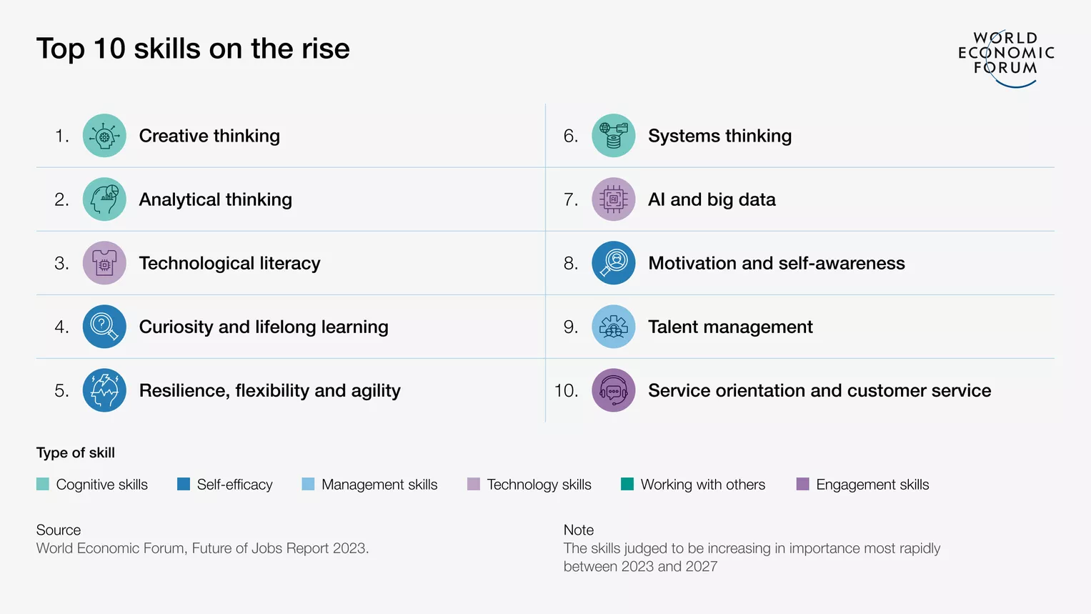
IUC AI Symposium June 11, 2024

Slide 10
IUC AI Symposium June 11, 2024
In 2022, China led global AI patent origins with 61.1%, significantly outpacing the United States, which accounted for 20.9% of AI patent origins (down from 54.1% in 2010).
Nestor Maslej, Loredana Fattorini, Raymond Perrault, Vanessa Parli, Anka Reuel, Erik Brynjolfsson, John Etchemendy, Katrina Ligett, Terah Lyons, James Manyika, Juan Carlos Niebles, Yoav Shoham, Russell Wald, and Jack Clark, “The AI Index 2024 Annual Report,” AI Index Steering Committee, Institute for Human-Centered AI, Stanford University, Stanford, CA, April 2024. https://aiindex.stanford.edu/wp-content/uploads/2024/04/HAI_AI-Index-Report-2024.pdf, page 14

Slide 11
IUC AI Symposium June 11, 2024
A 2023 McKinsey report reveals that 55% of organizations now use AI (including generative AI) in at least one business unit or function, up from 50% in 2022 and 20% in 2017.
Nestor Maslej, Loredana Fattorini, Raymond Perrault, Vanessa Parli, Anka Reuel, Erik Brynjolfsson, John Etchemendy, Katrina Ligett, Terah Lyons, James Manyika, Juan Carlos Niebles, Yoav Shoham, Russell Wald, and Jack Clark, “The AI Index 2024 Annual Report,” AI Index Steering Committee, Institute for Human-Centered AI, Stanford University, Stanford, CA, April 2024. https://aiindex.stanford.edu/wp-content/uploads/2024/04/HAI_AI-Index-Report-2024.pdf, page 19

Slide 12
IUC AI Symposium June 11, 2024
The title of the Oscar winning film, The Imitation Game, is taken from a test proposed by Alan Turing to benchmark AI.

Slide 13
IUC AI Symposium June 11, 2024
In 2023, several significant medical systems were launched, including EVEscape, which enhances pandemic prediction, and AlphaMissence, which assists in AI-driven mutation classification.
Nestor Maslej, Loredana Fattorini, Raymond Perrault, Vanessa Parli, Anka Reuel, Erik Brynjolfsson, John Etchemendy, Katrina Ligett, Terah Lyons, James Manyika, Juan Carlos Niebles, Yoav Shoham, Russell Wald, and Jack Clark, “The AI Index 2024 Annual Report,” AI Index Steering Committee, Institute for Human-Centered AI, Stanford University, Stanford, CA, April 2024. https://aiindex.stanford.edu/wp-content/uploads/2024/04/HAI_AI-Index-Report-2024.pdf, page 21

Slide 14
IUC AI Symposium June 11, 2024
AI systems have tripled performance rates on the MedQA, a key test for assessing AI’s clinical knowledge, since the benchmark’s introduction in 2019. GPT-4 Medprompt reached an accuracy rate of 90.2% in 2023.
Nestor Maslej, Loredana Fattorini, Raymond Perrault, Vanessa Parli, Anka Reuel, Erik Brynjolfsson, John Etchemendy, Katrina Ligett, Terah Lyons, James Manyika, Juan Carlos Niebles, Yoav Shoham, Russell Wald, and Jack Clark, “The AI Index 2024 Annual Report,” AI Index Steering Committee, Institute for Human-Centered AI, Stanford University, Stanford, CA, April 2024. https://aiindex.stanford.edu/wp-content/uploads/2024/04/HAI_AI-Index-Report-2024.pdf, page 21

Slide 15
IUC AI Symposium June 11, 2024
In 2023, industry produced 51 notable machine learning models, while academia contributed 15. There were also 21 notable models resulting from industry-academia collaborations in 2023, a new high.
Nestor Maslej, Loredana Fattorini, Raymond Perrault, Vanessa Parli, Anka Reuel, Erik Brynjolfsson, John Etchemendy, Katrina Ligett, Terah Lyons, James Manyika, Juan Carlos Niebles, Yoav Shoham, Russell Wald, and Jack Clark, “The AI Index 2024 Annual Report,” AI Index Steering Committee, Institute for Human-Centered AI, Stanford University, Stanford, CA, April 2024. https://aiindex.stanford.edu/wp-content/uploads/2024/04/HAI_AI-Index-Report-2024.pdf, page 14

Slide 16
IUC AI Symposium June 11, 2024
77% of devices being used have some form of AI.
https://www.authorityhacker.com/ai-statistics/

Slide 17
IUC AI Symposium June 11, 2024
By 2025, AI might eliminate 85 million jobs but create 97 million new ones, resulting in a net gain of 12 million jobs.
https://www.authorityhacker.com/ai-statistics/

Slide 18
IUC AI Symposium June 11, 2024
In 2022, the FDA approved 139 AI-related medical devices, a 12.1% increase from 2021. Since 2012, the number of FDA-approved AI-related medical devices has increased by more than 45-fold.
Nestor Maslej, Loredana Fattorini, Raymond Perrault, Vanessa Parli, Anka Reuel, Erik Brynjolfsson, John Etchemendy, Katrina Ligett, Terah Lyons, James Manyika, Juan Carlos Niebles, Yoav Shoham, Russell Wald, and Jack Clark, “The AI Index 2024 Annual Report,” AI Index Steering Committee, Institute for Human-Centered AI, Stanford University, Stanford, CA, April 2024. https://aiindex.stanford.edu/wp-content/uploads/2024/04/HAI_AI-Index-Report-2024.pdf, page 21

Slide 19
IUC AI Symposium June 11, 2024
According to Forbes, the most common uses for AI in business are:
Customer service – 56%
Cybersecurity and fraud management – 51%
Digital personal assistants – 47%
Customer relationship management – 46%
Inventory management – 40%
https://www.forbes.com/advisor/business/ai-statistics/

Slide 20
IUC AI Symposium June 11, 2024
The most popular job postings for AI in 2023 were:
Data engineer – 1898 postings
Data scientist – 1692 postings
Data analyst – 1206 postings
Machine learning engineer – 845 postings
Applied scientist – 269 postings
Research scientist – 232 postings
Analytics engineer- 232 postings
https://www.aiprm.com/ai-statistics/

Slide 21
IUC AI Symposium June 11, 2024
Companies’ AI-related card transaction volume increased by 293% year over year, compared to an increase of just 6% in overall software transaction volume during the same period.
https://ramp.com/blog/q1-2024-spending-insights?utm_medium=email&_hsenc=p2ANqtz-_X8XXFi91U36SX2o69FsLk4w0xOCiFmf3ogKz2Mkzl135ioFVo1EWtMqKKY8ox-xKVn8F9gTm5o7L91tfYTR42saws0Q&_hsmi=309047631&utm_content=309047631&utm_source=hs_email

Slide 22
IUC AI Symposium June 11, 2024
The first computer to beat a World Chess Champion was IBM's Deep Blue in 1997. Deep Blue won 3.5 games to 2.5 games over Gary Kasparov.

Slide 23
IUC AI Symposium June 11, 2024
The healthcare and biotech sector saw the largest year-over-year increase in the number of companies transacting with AI vendors (131%), while tech saw the slowest growth (45%).
https://ramp.com/blog/q1-2024-spending-insights?utm_medium=email&_hsenc=p2ANqtz-_X8XXFi91U36SX2o69FsLk4w0xOCiFmf3ogKz2Mkzl135ioFVo1EWtMqKKY8ox-xKVn8F9gTm5o7L91tfYTR42saws0Q&_hsmi=309047631&utm_content=309047631&utm_source=hs_email

Slide 24
IUC AI Symposium June 11, 2024
Only a third of consumers think they are using AI platforms, while actual usage is 77%.
https://www.authorityhacker.com/ai-statistics/

Slide 25
IUC AI Symposium June 11, 2024
9 in 10 students want to learn more about AI in school.
https://www.aiprm.com/ai-statistics/

